Slide 1
Boxing UnBoxing, Type Conversion and Console Read

Slide 2
Boxing and Unboxing
Boxing and Unboxing are important concepts used in the C# type system.
They are used to create a link between the two major data types in C#.
All value types are stored in stack but in some situations they need to referenced as heap as reference types are stored in heap.
When the data moves from value types to reference types, it is termed ‘Boxing’ and the reverse is termed ‘……………………’.
Boxing is required in situations when a value type is converted into base object.
CLR converts the value type into the reference type allocates the memory on heap and copies the value type instant to it.

Slide 3
Boxing and Unboxing
Unboxing is the process of converting an instance of object type or interface back to the value type.
This is done explicitly by using the unboxing.
Syntax:
int i =1;
object O=i;
int j = int (O);

Slide 4
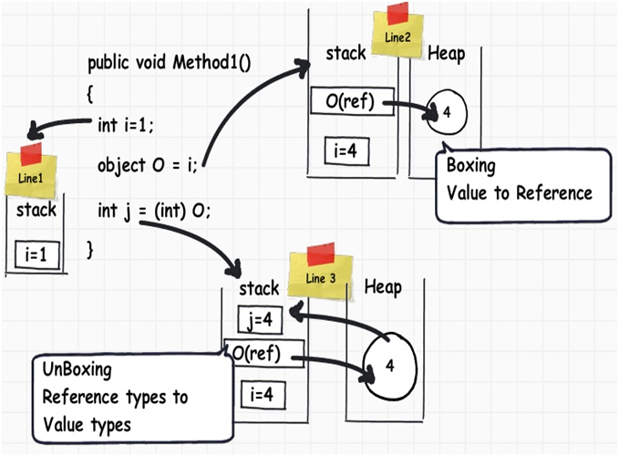

Slide 5
Type Conversion
While working in C# applications we often need to perform a typical task that is conversion one data type to another .
Type casting has two forms
Implicit
Explicit

Slide 6
Implicit Conversion
The Conversion perform by the programing language in type safe manner .
For eg
float floatValue= 2.5f;
Double doubleValue=floatValue;

Slide 7
Type Casting or Explicit conversion
These conversions are done explicitly by users using the pre-defined functions.
Explicit conversions require a cast operator.
For eg:
double d = 5673.74;
int i;
// cast double to int.
i = (int)d;
Console.WriteLine(i);
Console.ReadKey();

Slide 8
Console Readline
Console.ReadLine reads input from the console.
When the user presses enter, it returns a string.
Then resume the program and process the string to determine the next action to take.
Syntax:
int i = Console.Read();
Console.WriteLine(i);
ConsoleKeyInfo info = Console.ReadKey();
Console.WriteLine(info.Key);

Slide 9
Task
Convert the String IsTrue=“true” to Boolean data type also convert int isIntTrue=0 to Boolean data type implicity.
Use toString method to the convert integer float and double varaibles to the string data type varaibles.
Convert float data type varaible to int long and short data type explicitly.
WAP to assign value to meaningful variables of data types int, float ,char, String, bool ,double taking input from user.

